Slide 1
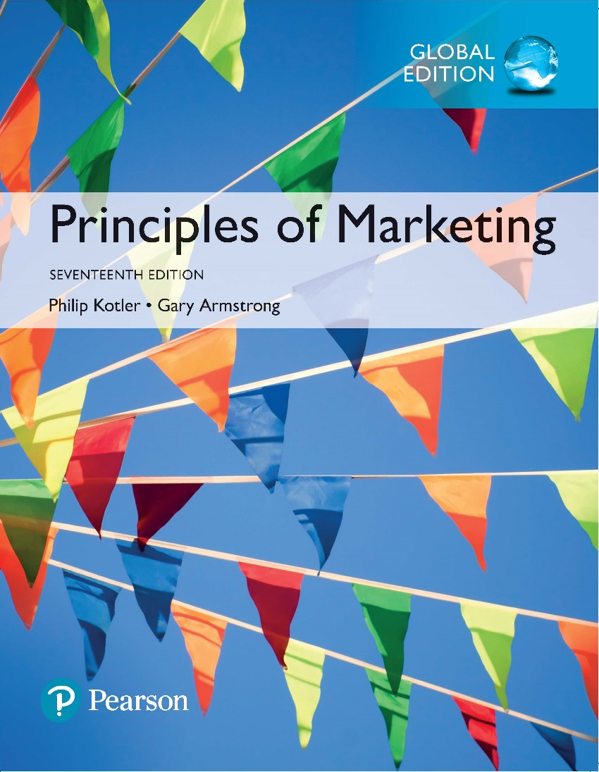
Principles of Marketing Seventeenth Edition
Chapter 10
Pricing: Understanding and Capturing Customer Value
Copyright © 2018 Pearson Education Ltd. All Rights Reserved.

Slide 2
Learning Objectives
10-1 Answer the question “What is a price?” and discuss the importance of pricing in today’s fast-changing environment.
10-2 Identify the three major pricing strategies and discuss the importance of understanding customer-value perceptions, company costs, and competitor strategies when setting prices.
10-3 Identify and define the other important external and internal factors affecting a firm’s pricing decisions.

Slide 3
Learning Objective 1
Answer the question “What is a price?” and discuss the importance of pricing in today’s fast-changing environment.

Slide 4
What Is a Price?
Price is the amount of money charged for a product or service, or the sum of all the values that customers exchange for the benefits of having or using the product or service.
Notes:
Discussion Question
How does a company like Starbucks price their products?
This will lead to a good overview of the chapter as students will most likely focus on customers, costs and competitors.
Historically, price has been the major factor affecting buyer choice. In recent decades, however, nonprice factors have gained increasing importance. Even so, price remains one of the most important elements that determines a firm’s market share and profitability.
In the narrowest sense, price is the amount of money charged for a product or a service. More broadly, price is the sum of all the values that customers give up to gain the benefits of having or using a product or service
Price is the only element in the marketing mix that produces revenue; all other elements represent costs.
Price is also one of the most flexible marketing mix elements; prices can be changed quickly. Smart managers treat pricing as a key strategic tool for creating customer value and building customer relationships. Prices have a direct impact on a firm’s bottom line.

Slide 5
Learning Objective 2
Identify the three major pricing strategies and discuss the importance of understanding customer-value perceptions, company costs, and competitor strategies when setting prices.

Slide 6
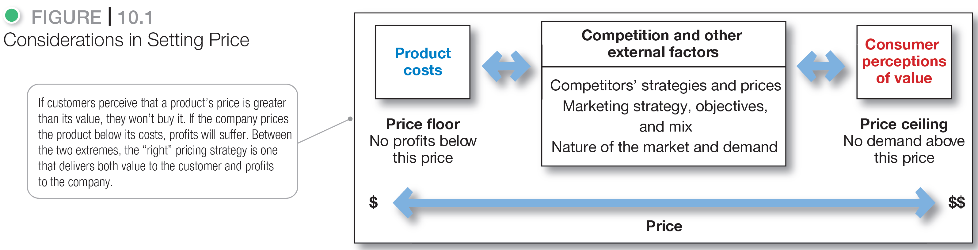
Major Pricing Strategies
Notes:
Figure 10.1 suggests three major pricing strategies: customer value-based pricing, cost-based pricing, and competition-based pricing.
The price the company charges will fall somewhere between one that is too low to produce a profit and one that is too high to produce any demand.
Figure 10.1 summarizes the major considerations in setting price. Customer perceptions of the product’s value set the ceiling for prices. Likewise, product costs set the floor for a product’s price.
In setting its price between these two extremes, the company must consider several external and internal factors, including competitors’ strategies and prices, the overall marketing strategy and mix, and the nature of the market and demand.

Slide 7
Major Pricing Strategies
Customer Value-Based Pricing
Value-based pricing uses the buyers’ perceptions of value rather than the seller’s cost.
Value-based pricing is customer driven.
Cost-based pricing is product driven.
Price is set to match perceived value.
Notes:
Note to Instructor
Students often confuse value with low price. You might want to bring up a product that some of them will value even at a high price. You can bring up the latest iPhone product or a luxury car. Some students will feel that the price for these products is too high, however, others will see the value these products offer to the consumer.
Customer Value-Based Pricing
In the end, the customer will decide whether a product’s price is right. Pricing decisions, like other marketing mix decisions, must start with customer value. Effective customer-oriented pricing involves understanding how much value consumers place on the benefits they receive from the product and setting a price that captures that value.
Figure 10.2 (shown on the next slide) compares value-based pricing with cost-based pricing. Although costs are an important consideration in setting prices, cost-based pricing is often product driven and sets a price that covers costs plus a target profit. Marketing must then convince buyers that the product’s value at that price justifies its purchase. If the price turns out to be too high, the company must settle for lower markups or lower sales, both resulting in disappointing profits.
In the end, the customer will decide whether a product’s price is right. Pricing decisions, like other marketing mix decisions, must start with customer value. When customers buy a product, they exchange something of value (the price) to get something of value (the benefits of having or using the product). Effective, customer-oriented pricing involves understanding how much value consumers place on the benefits they receive from the product and setting a price that captures that value.
Customer value-based pricing uses buyers’ perceptions of value as the key to pricing. Value-based pricing means that the marketer cannot design a product and marketing program and then set the price.
Figure 10.2 compares value-based pricing with cost-based pricing. Although costs are an important consideration in setting prices, cost-based pricing is often product driven. The company designs what it considers to be a good product, adds up the costs of making the product, and sets a price that covers costs plus a target profit. Marketing must then convince buyers that the product’s value at that price justifies its purchase. If the price turns out to be too high, the company must settle for lower markups or lower sales, both resulting in disappointing profits.
Value-based pricing reverses this process. The company first assesses customer needs and value perceptions. It then sets its target price based on customer perceptions of value. The targeted value and price drive decisions about what costs can be incurred and the resulting product design. As a result, pricing begins with analyzing consumer needs and value perceptions, and the price is set to match perceived value.
It’s important to remember that “good value” is not the same as “low price.” For example, a Steinway piano—any Steinway piano—costs a lot. But to those who own one, a Steinway is a great value.

Slide 8
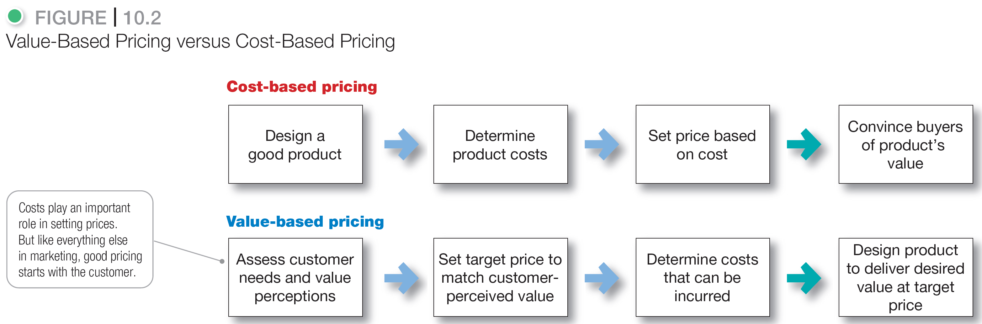
Major Pricing Strategies
Notes:
Figure 10.2: Value-Based Pricing vs. Cost-Based Pricing

Slide 9
Major Pricing Strategies
Customer Value-Based Pricing
Good-value pricing is offering just the right combination of quality and good service at a fair price.
Notes:
The Great Recession of 2008 to 2009 caused a fundamental and lasting shift in consumer attitudes toward price and quality. In response, many companies have changed their pricing approaches to bring them in line with changing economic conditions and consumer price perceptions.
More and more, marketers have adopted the strategy of good-value pricing—offering the right combination of quality and good service at a fair price. In many cases, this has involved introducing less-expensive versions of established brand name products or new lower-price lines.
In other cases, good-value pricing has involved redesigning existing brands to offer more quality for a given price or the same quality for less. Some companies even succeed by offering less value but at very low prices. For example, the ALDI supermarket chain has established an impressive good-value pricing position by which it gives customers “more ‘mmm’ for the dollar.” ALDI practices everyday low pricing (EDLP).
EDLP involves charging a constant, everyday low price with few or no temporary price discounts. The king of EDLP is Walmart, which practically defined the concept.

Slide 10
Major Pricing Strategies
Customer Value-Based Pricing
Everyday low pricing (EDLP) involves charging a constant everyday low price with few or no temporary price discounts.
Notes:
Good-value pricing: ALDI keeps costs low so that it can offer customers “impressively high quality at impossibly low prices” every day.

Slide 11
Major Pricing Strategies
Customer Value-Based Pricing
High-low pricing involves charging higher prices on an everyday basis but running frequent promotions to lower prices temporarily on selected items.
Notes:
Department stores such as Sears and Macy’s practice high-low pricing by having frequent sale days, early-bird savings, and bonus earnings for store credit-card holders.

Slide 12
Major Pricing Strategies
Customer Value-Based Pricing
Value-added pricing attaches value-added features and services to differentiate the companies offers and thus their higher prices.
Notes:
Value-based pricing doesn’t mean simply charging what customers want to pay or setting low prices to meet competition. Instead, many companies adopt value-added pricing strategies rather than cut prices to match competitors.
For example, even as frugal consumer spending habits linger, some movie theater chains are adding amenities and charging more rather than cutting services to maintain lower admission prices.

Slide 13
Major Pricing Strategies
Cost-Based Pricing
Cost-based pricing sets prices based on the costs for producing, distributing, and selling the product plus a fair rate of return for effort and risk.
Notes:
Whereas customer-value perceptions set the price ceiling, costs set the floor for the price that the company can charge.
Some companies, such as Walmart or Southwest Airlines, work to become the low-cost producers in their industries. Companies with lower costs can set lower prices that result in smaller margins but greater sales and profits. However, other companies—such as Apple, BMW, and Steinway—intentionally pay higher costs so that they can add value and claim higher prices and margins.

Slide 14
Major Pricing Strategies
Cost-Based Pricing
Fixed costs are the costs that do not vary with production or sales level.
Rent
Heat
Interest
Executive salaries
Notes:
Fixed costs (also known as overhead) are costs that do not vary with production or sales level.

Slide 15
Major Pricing Strategies
Cost-Based Pricing
Variable costs vary directly with the level of production.
Raw materials
Packaging
Notes:
Variable costs vary directly with the level of production. Each PC produced by HP involves a cost of computer chips, wires, plastic, packaging, and other inputs. Although these costs tend to be the same for each unit produced, they are called variable costs because the total varies directly with the number of units produced.

Slide 16
Major Pricing Strategies
Cost-Based Pricing
Total costs are the sum of the fixed and variable costs for any given level of production.
Notes:
Management wants to charge a price that will at least cover the total production costs at a given level of production.
The company must watch its costs carefully. If it costs the company more than its competitors to produce and sell a similar product, the company will need to charge a higher price or make less profit, putting it at a competitive disadvantage.

Slide 17
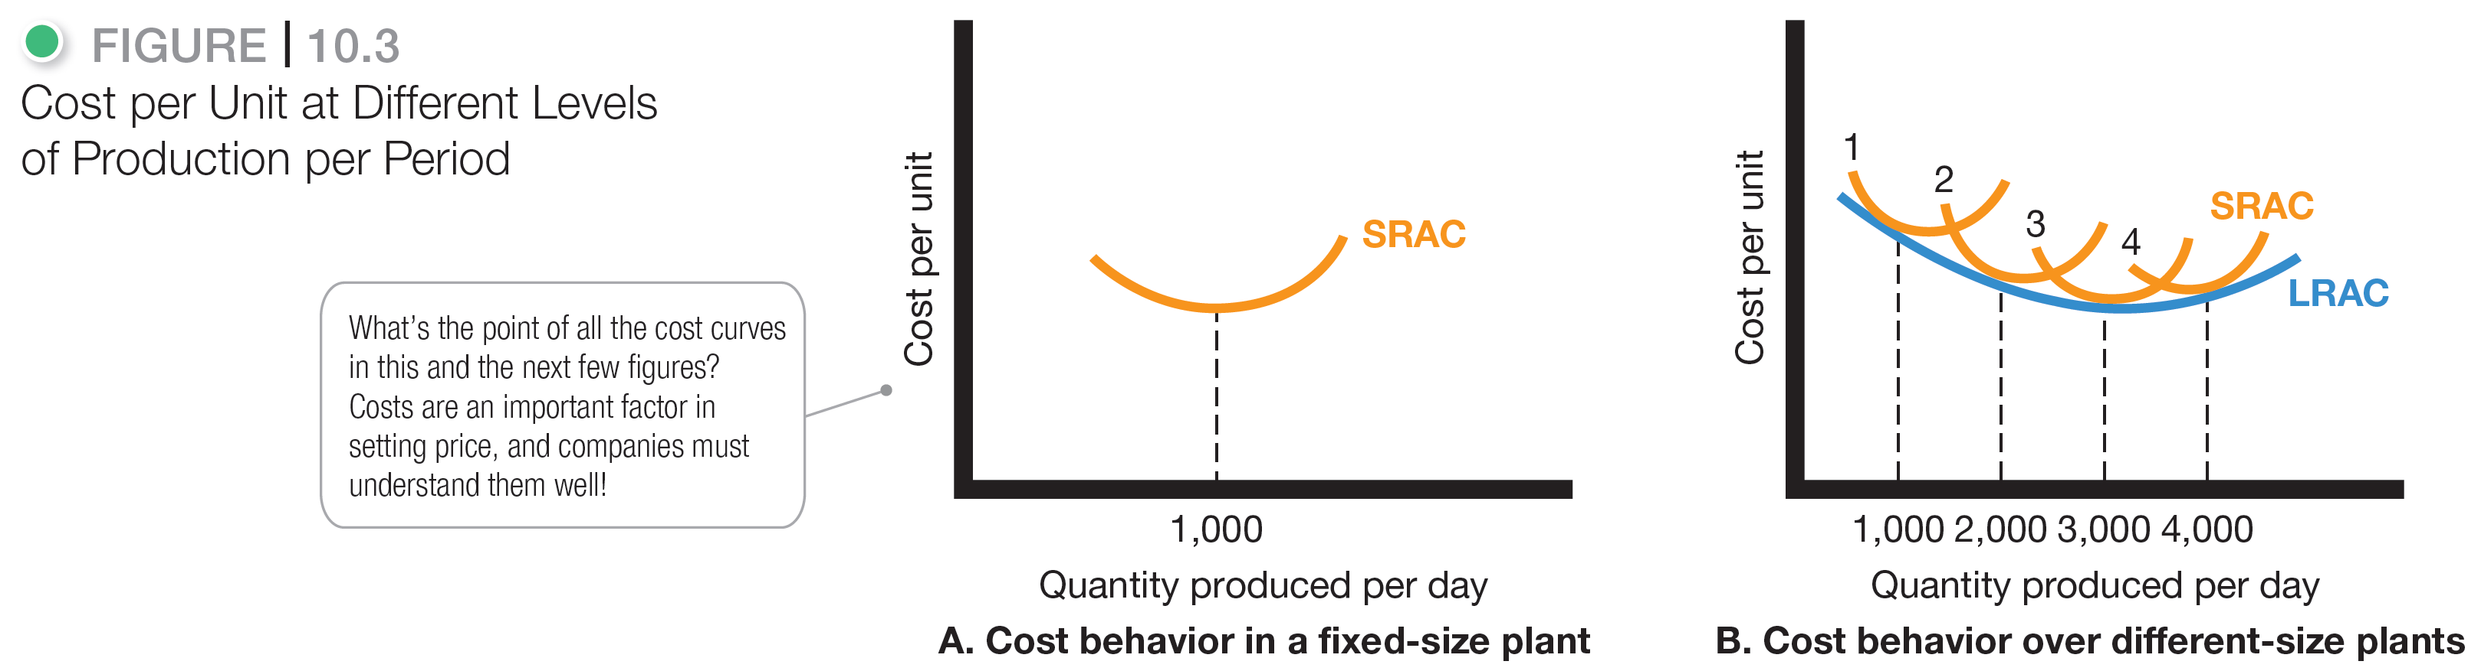
Major Pricing Strategies
Notes:
Note to Instructor
It is best to use an example like the Texas Instruments (TI) example given in the book:
Suppose TI has built a plant to produce 1,000 calculators per day. Figure 10.3A shows the typical short‑run average cost curve (SRAC). It shows that the cost per calculator is high if TI’s factory produces only a few per day. But as production moves up to 1,000 calculators per day, average cost falls. This is because fixed costs are spread over more units, with each one bearing a smaller share of the fixed cost. TI can try to produce more than 1,000 calculators per day, but average costs will increase because the plant becomes inefficient. Workers have to wait for machines, the machines break down more often, and workers get in each other’s way.
If TI believed it could sell 2,000 calculators a day, it should consider building a larger plant. The plant would use more efficient machinery and work arrangements. Also, the unit cost of producing 2,000 calculators per day would be lower than the unit cost of producing 1,000 units per day, as shown in the long‑run average cost (LRAC) curve (Figure 10.3B).
In fact, a 3,000‑capacity plant would even be more efficient, according to Figure 10.3B. But a 4,000-daily production plant would be less efficient because of increasing diseconomies of scale—too many workers to manage, paperwork slowing things down, and so on.
Figure 10.3B shows that a 3,000-daily production plant is the best size to build if demand is strong enough to support this level of production.

Slide 18
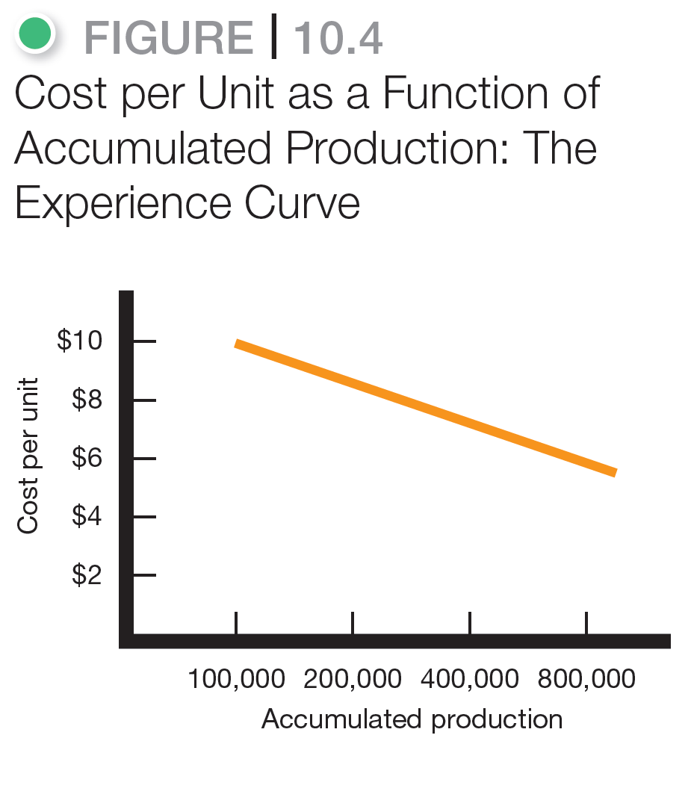
Major Pricing Strategies
Notes:
Note to Instructor
The TI example continues as follows with Figure 10.4:
Suppose TI runs a plant that produces 3,000 calculators per day. As TI gains experience in producing calculators, it learns how to do it better. This drop in the average cost with accumulated production experience is called the experience curve (or the learning curve).
If a downward-sloping experience curve exists, this is highly significant for the company. Not only will the company’s unit production cost fall, but it will fall faster if the company makes and sells more during a given time period. But the market has to stand ready to buy the higher output. And to take advantage of the experience curve, TI must get a large market share early in the product’s life cycle. This suggests the following pricing strategy: TI should price its calculators low; its sales will then increase, and its costs will decrease through gaining more experience, and then it can lower its prices further. Some companies have built successful strategies around the experience curve.

Slide 19
Major Pricing Strategies
Cost-Based Pricing
Cost-plus pricing adds a standard markup to the cost of the product.
Benefits
Sellers are certain about costs.
Price competition is minimized.
Buyers feel it is fair.
Disadvantages
Ignores demand and competitor prices
Notes:
The simplest pricing method is cost-plus pricing (or markup pricing). Price is calculated by adding a standard markup to the manufacturer’s costs.
To illustrate markup pricing, suppose a manufacturer of toasters has a cost of $16/unit. If the manufacturer wants to earn a 20 percent markup on sales, the price is calculated by the following:
markup price = unit cost/(1 - desired return on sales) =$16/(1 - .2) = $20
The manufacturer would charge dealers $20 per unit and make a profit of $4 per unit. The dealers, in turn, will mark up the toaster. If dealers want to earn 50 percent on the sales price, they will mark up the toaster to $40 ($20 + 50% of $40). This number is equivalent to a markup on cost of 100 percent ($20/$20).
Does using standard markups to set prices make sense? Generally, no. Any pricing method that ignores demand and competitor prices is not likely to lead to the best price. Still, markup pricing remains popular for many reasons.
Sellers are more certain about costs than about demand
By tying the price to cost, sellers simplify pricing.
There is no need to make frequent adjustments as demand changes.
If the industry uses this method, prices tend to be similar and price competition is minimized.
Many people feel that cost-plus pricing is fairer to both buyers and sellers.
Sellers earn a fair return but do not take advantage of buyers if demand becomes great.

Slide 20
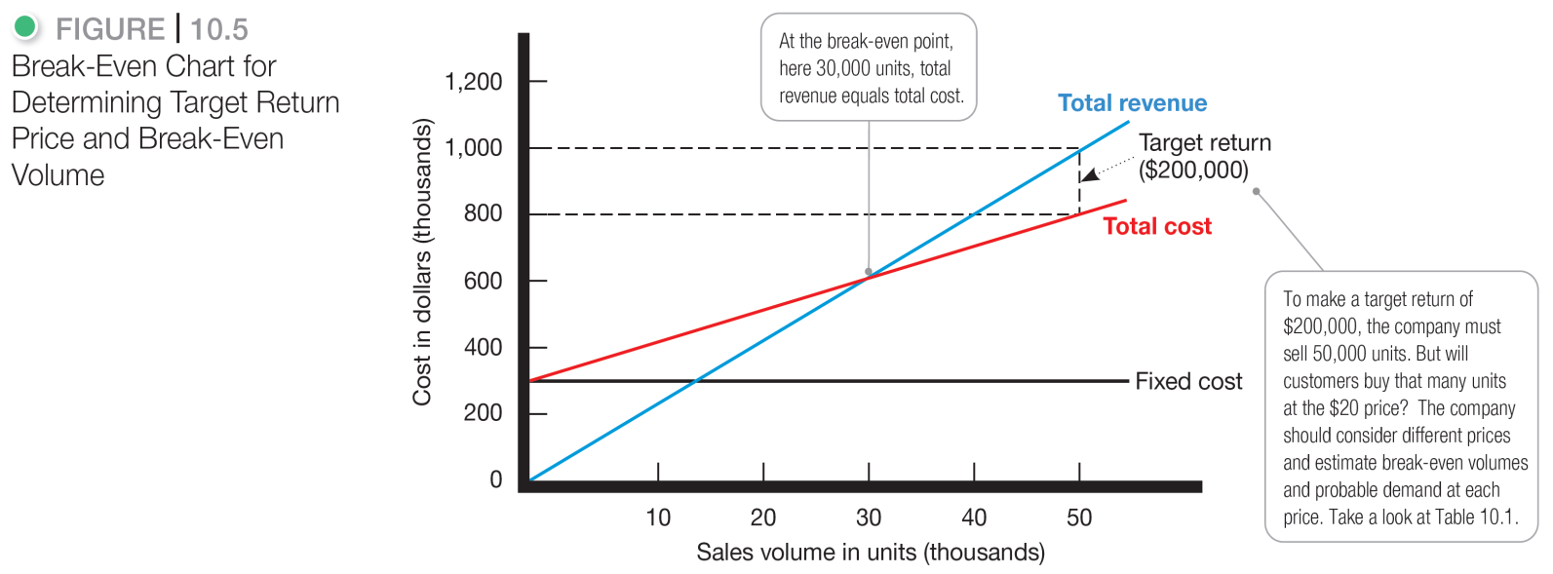
Major Pricing Strategies
Cost-Based Pricing
Break-even pricing (target return pricing) is setting price to break even on costs or to make a target return.
Figure 10.5 Break-Even Chart for Determining Target Return Price and Break-Even Volume.
Notes:
Another cost-oriented pricing approach is break-even pricing (or a variation called target return pricing). The firm tries to determine the price at which it will break even or make the target return it is seeking.
Target return pricing uses the concept of a break-even chart, which shows the total cost and total revenue expected at different sales volume levels.

Slide 21
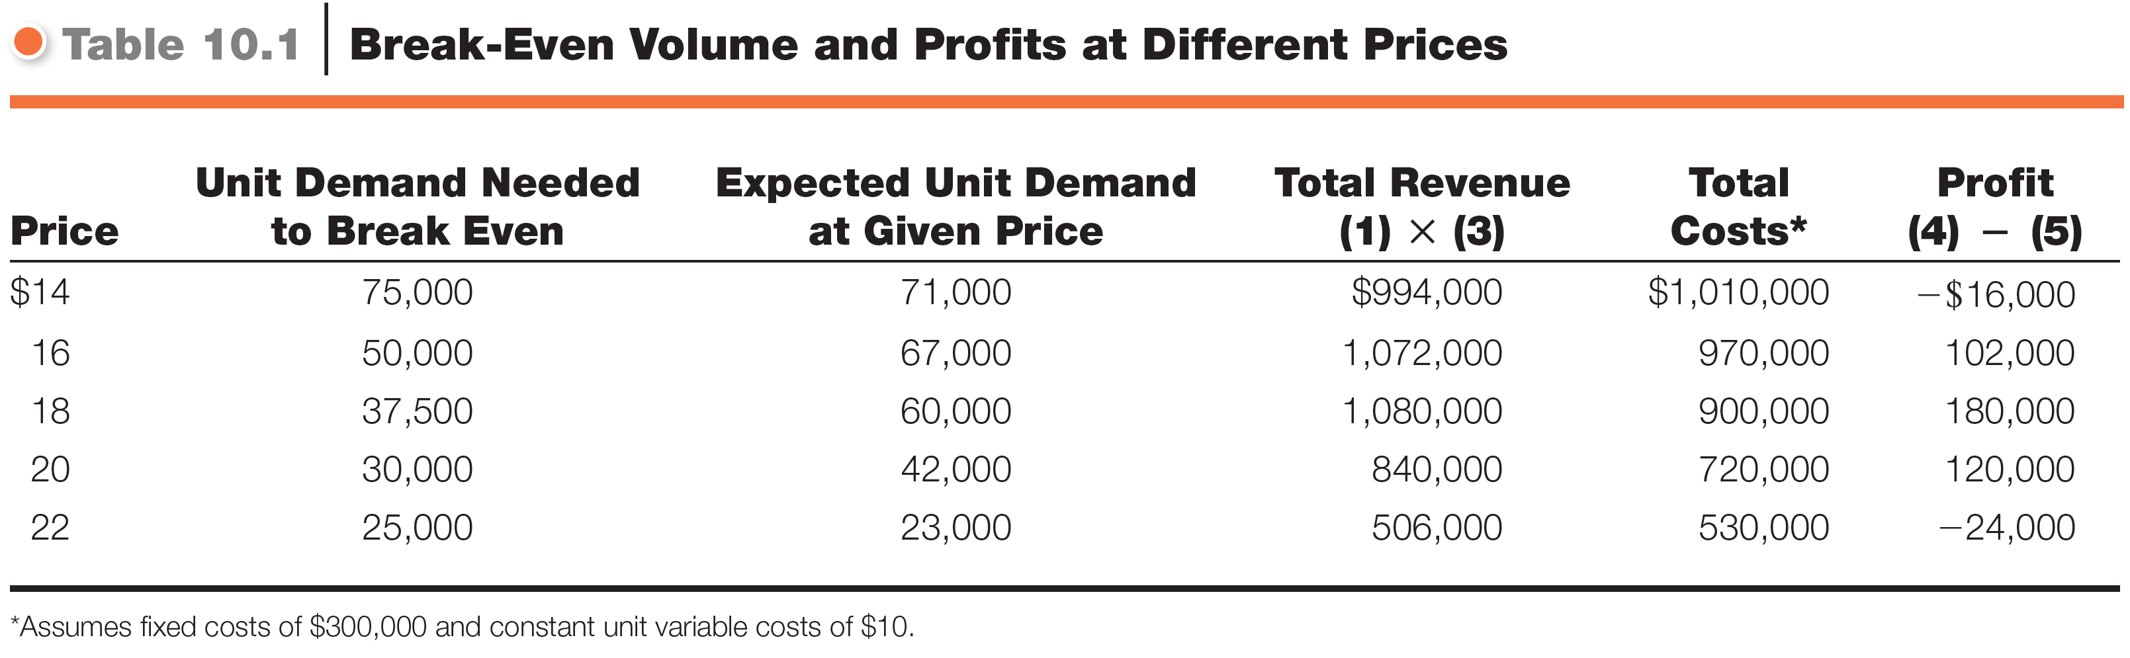
Major Pricing Strategies
Notes:
From the toaster example on the previous two slides, the manufacturer should consider different prices and estimate break-even volumes, probable demand, and profits for each. This is done in Table 10.1. The table shows that as price increases, the break-even volume drops (column 2). But as price increases, the demand for toasters also decreases (column 3).
The manufacturer should consider different prices and estimate break-even volumes, probable demand, and profits for each. This is done in Table 10.1. The table shows that as price increases, the break-even volume drops (column 2). as price increases, the demand for toasters also decreases (column 3).

Slide 22
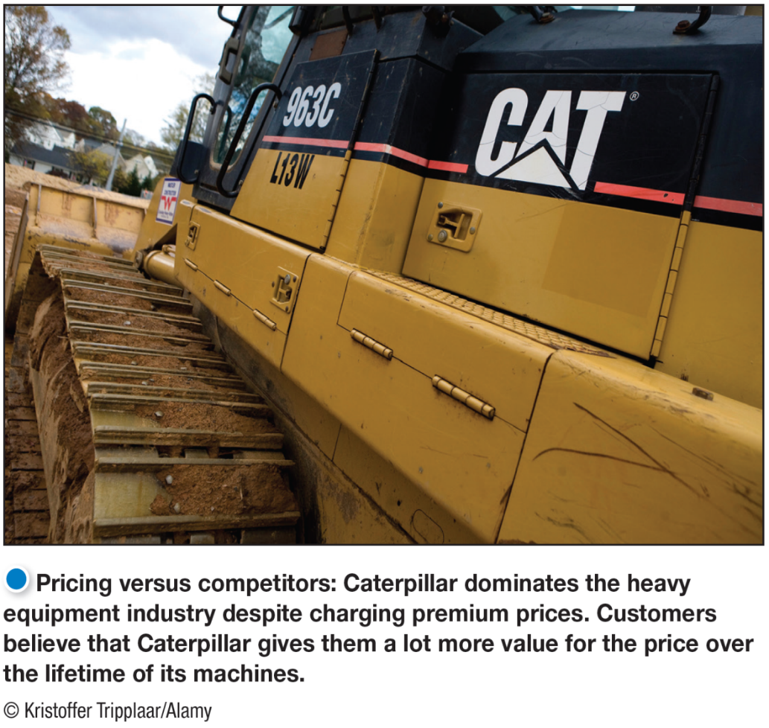
Major Pricing Strategies
Competition-Based Pricing
Competition-based pricing is setting prices based on competitors’ strategies, costs, prices, and market offerings.
Notes:
Pricing versus competitors: Caterpillar dominates the heavy equipment industry despite charging premium prices. Customers believe that Caterpillar gives them a lot more value for the price over the lifetime of its machines.
Competition-based pricing involves setting prices based on competitors’ strategies, costs, prices, and market offerings. Consumers will base their judgments of a product’s value on the prices that competitors charge for similar products.
In assessing competitors’ pricing strategies, the company should ask:
How does the company’s market offering compare with competitors’ offerings in terms of customer value?
How strong are current competitors and what are their current pricing strategies?

Slide 23
Learning Objective 3
Identify and define the other important external and internal factors affecting a firm’s pricing decisions.
Notes:
Discussion Question
What other issues beyond the market and the economy must marketers consider when setting prices?
Other internal factors that influence pricing decisions include the company’s overall marketing strategy, objectives, and marketing mix, as well as organizational considerations. Price is only one element of the company’s broader marketing strategy. If the company has selected its target market and positioning carefully, then its marketing mix strategy, including price, will be fairly straightforward. Common pricing objectives might include customer retention and building profitable customer relationships, preventing competition, supporting resellers and gaining their support, or avoiding government intervention. Price decisions must be coordinated with product design, distribution, and promotion decisions to form a consistent and effective marketing program. Finally, in order to coordinate pricing goals and decisions, management must decide who within the organization is responsible for setting price.
Other external pricing considerations include the nature of the market and demand and environmental factors such as the economy, reseller needs, and government actions. Ultimately, the customer decides whether the company has set the right price. The customer weighs the price against the perceived values of using the product—if the price exceeds the sum of the values, consumers will not buy. So the company must understand such concepts as demand curves (the price–demand relationship) and price elasticity (consumer sensitivity to prices).
.

Slide 24
Other Considerations Affecting Price Decisions
The Market and Demand
Pricing In Different Types of Markets
Pure competition
Monopolistic competition
Oligopolistic competition
Pure monopoly
Notes:
Discussion Question
Discuss how the Internet has changed pricing competition?
Under pure competition, the market consists of many buyers and sellers trading in a uniform commodity, such as wheat, copper, or financial securities. No single buyer or seller has much effect on the going market price. Thus, sellers in these markets do not spend much time on marketing strategy.
Under monopolistic competition, the market consists of many buyers and sellers who trade over a range of prices because sellers can differentiate their offers to buyers.
Under oligopolistic competition, the market consists of only a few large sellers. For example, only four companies—Verizon, AT&T, Sprint, and T-Mobile—control more than 90 percent of the U.S. wireless service provider market. Each seller is alert and responsive to competitors’ pricing strategies and marketing moves.
In a pure monopoly, the market is dominated by one seller. The seller may be a government monopoly (the U.S. Postal Service), a private regulated monopoly (a power company), or a private unregulated monopoly (De Beers and diamonds). Pricing is handled differently in each case.

Slide 25
Other Considerations Affecting Price Decisions
The Economy and Other External Factors
Economic conditions
Reseller’s response to price
Government
Social concerns
Notes:
The Economy
Economic conditions can have a strong impact on the firm’s pricing strategies. Economic factors such as a boom or recession, inflation, and interest rates affect pricing decisions because they affect consumer spending, consumer perceptions of the product’s price and value, and the company’s costs of producing and selling a product.
Consumers have tightened their belts and become more value conscious. The most obvious response to the new economic realities is to cut prices and offer discounts. Many companies have done just that to help spur short-term sales. However, lower prices mean lower margins and deep discounts may cheapen a brand in consumers’ eyes. And once a company cuts prices, it’s difficult to raise them again when the economy recovers.
Rather than cutting prices, many companies have instead shifted their marketing focus or added more affordable lines to their product mixes.
Other companies are holding their price positions but redefining the “value” in their value propositions. Remember, even in tough economic times, consumers do not buy based on prices alone. They balance the price they pay against the value they receive. Thus, no matter what price they charge—low or high—companies need to offer great value for the money.
Other External Factors
The company must consider several other factors in its external environment when setting prices.
The company should set prices that give resellers a fair profit, encourage their support, and help them to sell the product effectively.
The government is another important external influence on pricing decisions.
Social concerns may need to be taken into account. In setting prices, a company’s short-term sales, market share, and profit goals may need to be tempered by broader societal considerations.

